Slide 1
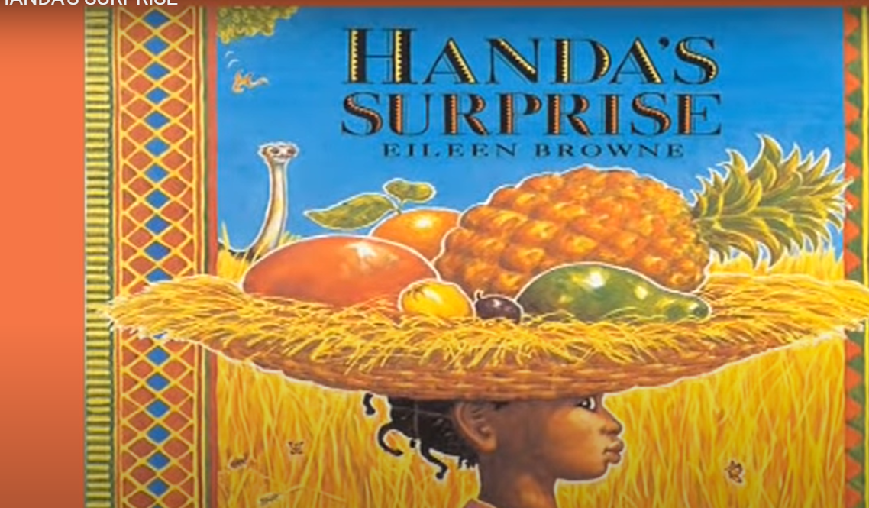
Resources
Banana, bowl, potato masher
Air freshener
Sponge, bowl, orange squash
Frozen mango chunks
Spiky leaves (holly works well)
Hand cream
Jelly (yellow)
Soft toys or light balls and container
Tangerine

Slide 3
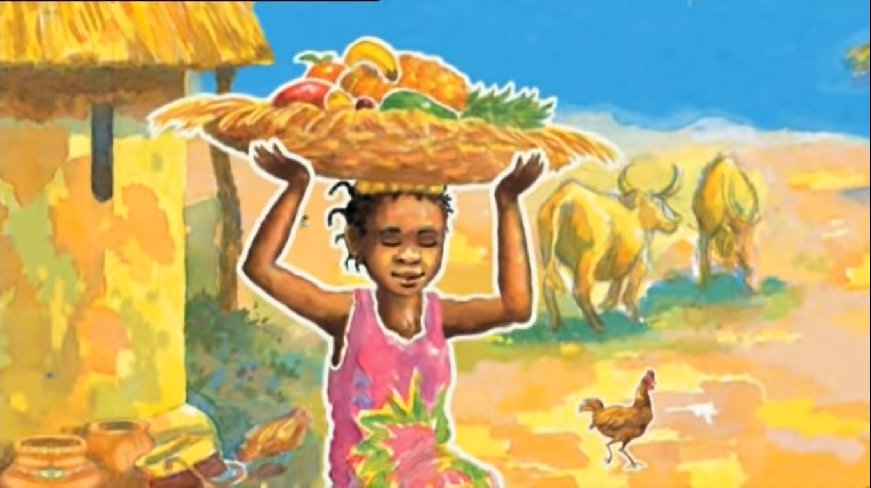
Handa put seven delicious fruits in a basket for her friend, Akeyo.

Slide 4
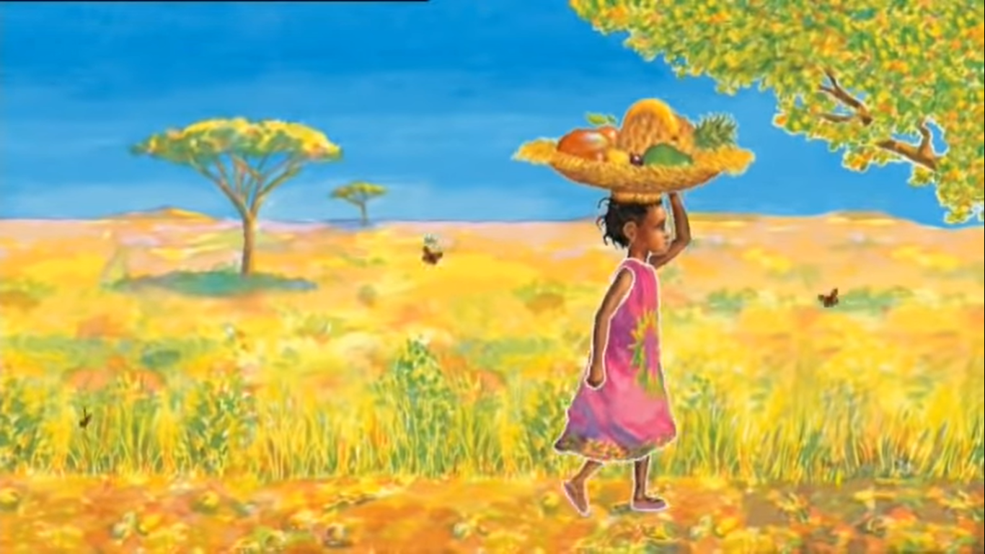
She will be surprised, thought Handa, as she set off for Akeyo’s village. I wonder which fruit she’ll like best?

Slide 5
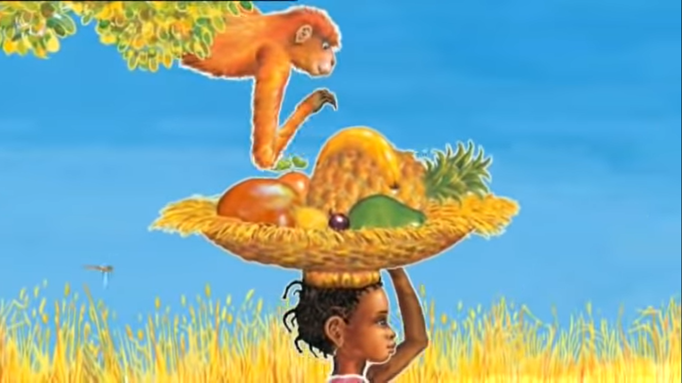
Will she like the soft, yellow banana?
Mash and squash banana with fork, hands or feet

Slide 6
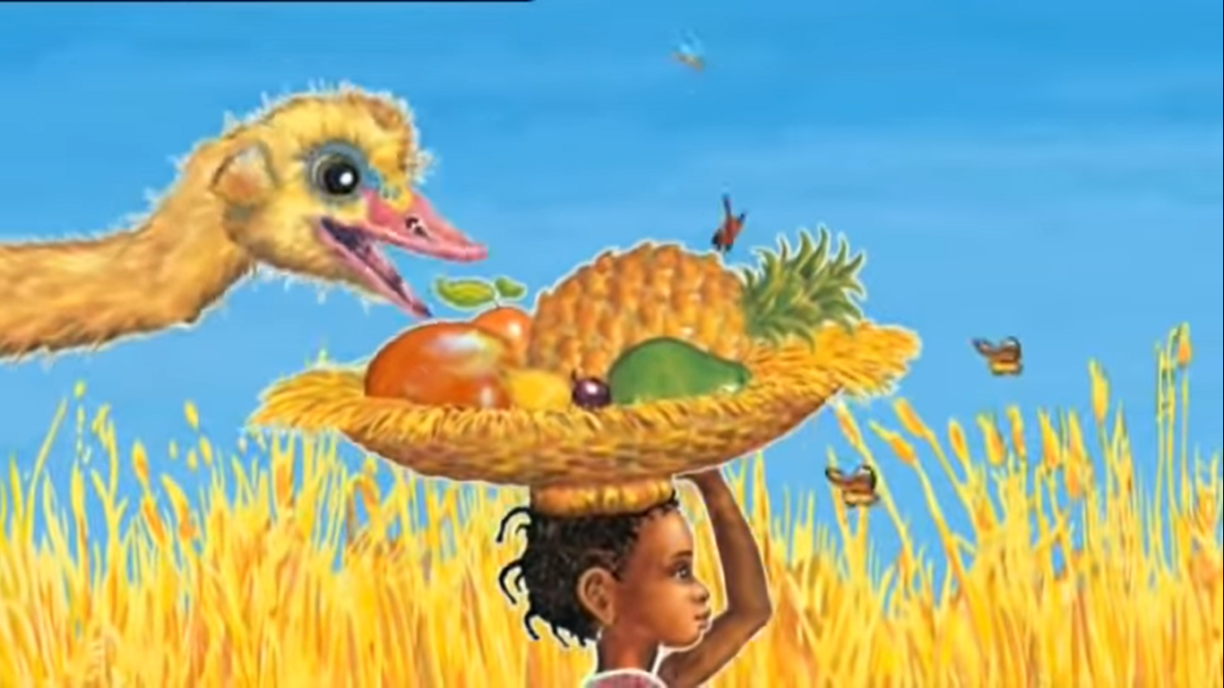
or the sweet-smelling guava?
Air freshener: spray and smell.

Slide 7
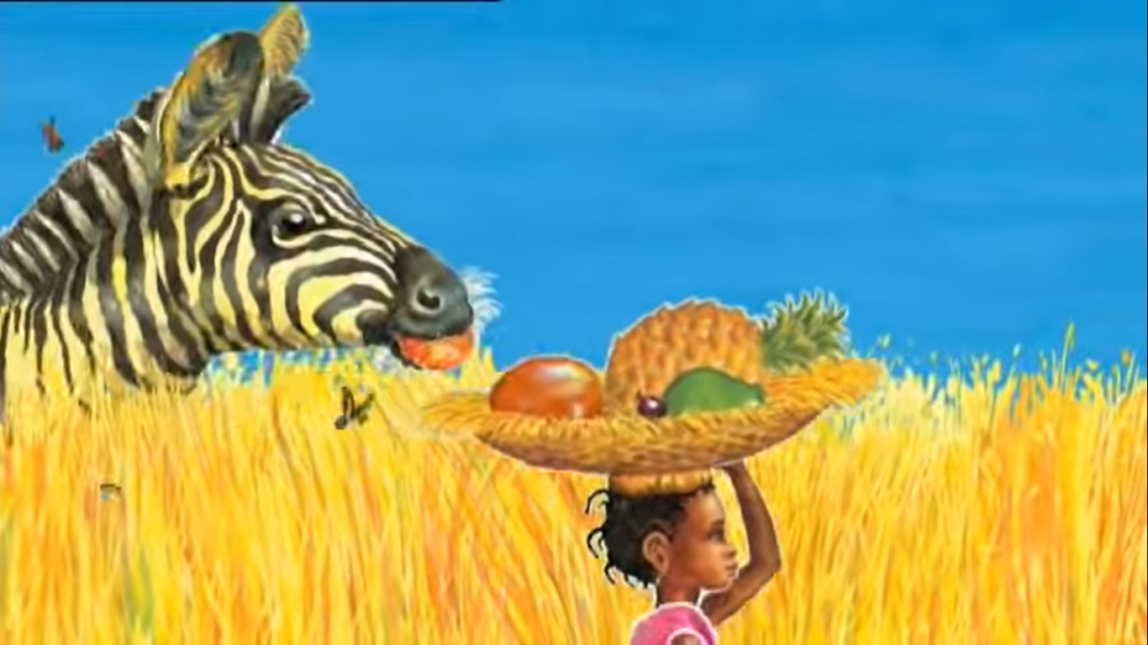
Will she like the round, juicy orange?
Squeeze sponges wet with orange squash.

Slide 8
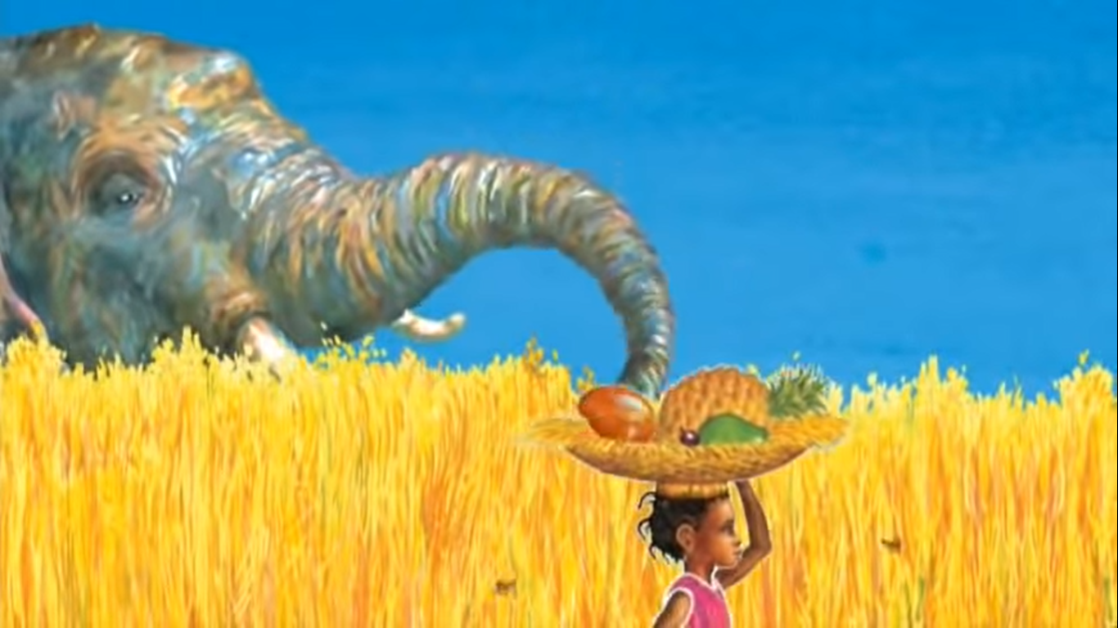
Or the ripe, red mango?
Try tasting frozen mango chunks.

Slide 9
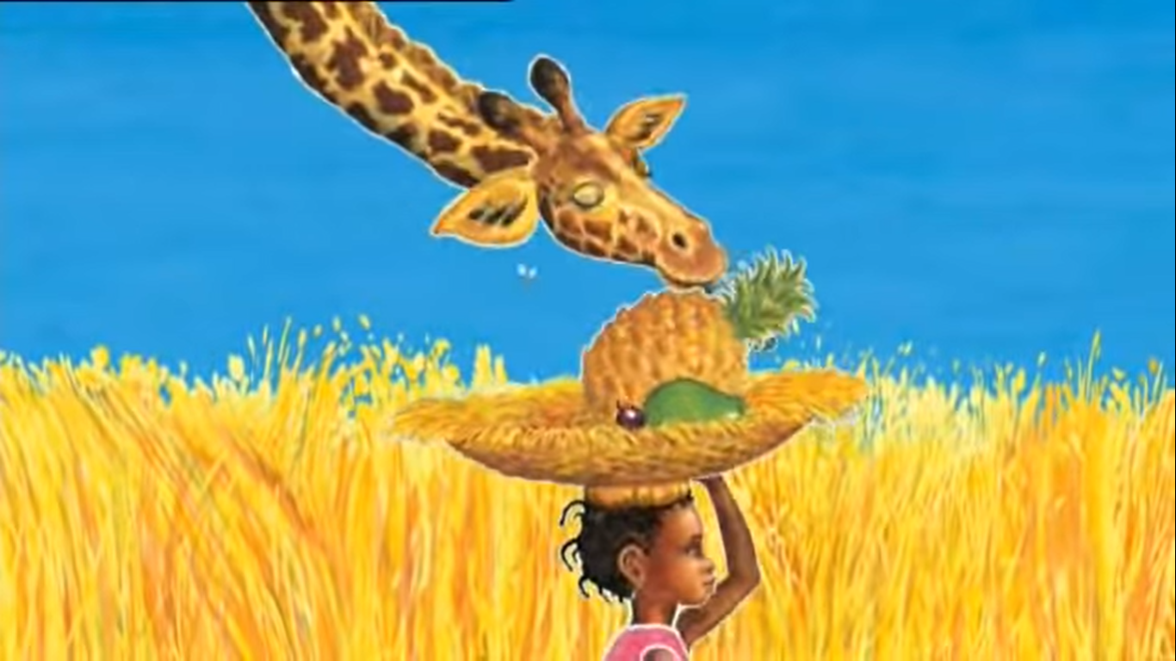
Will she like the spiky-leaved pineapple,
Touch spiky leaves. Model pricking your finger!

Slide 10
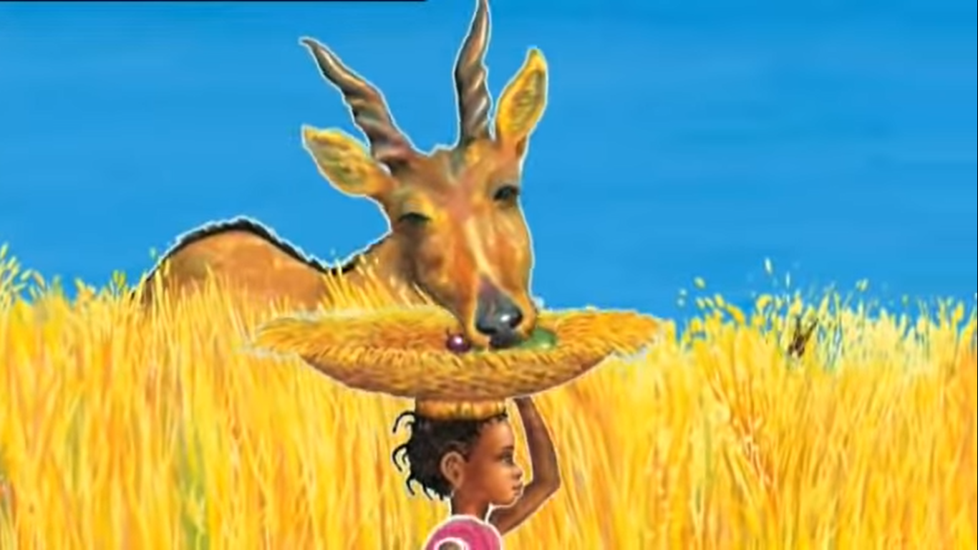
the creamy, green avocado…
Massage hand-cream over hands

Slide 11
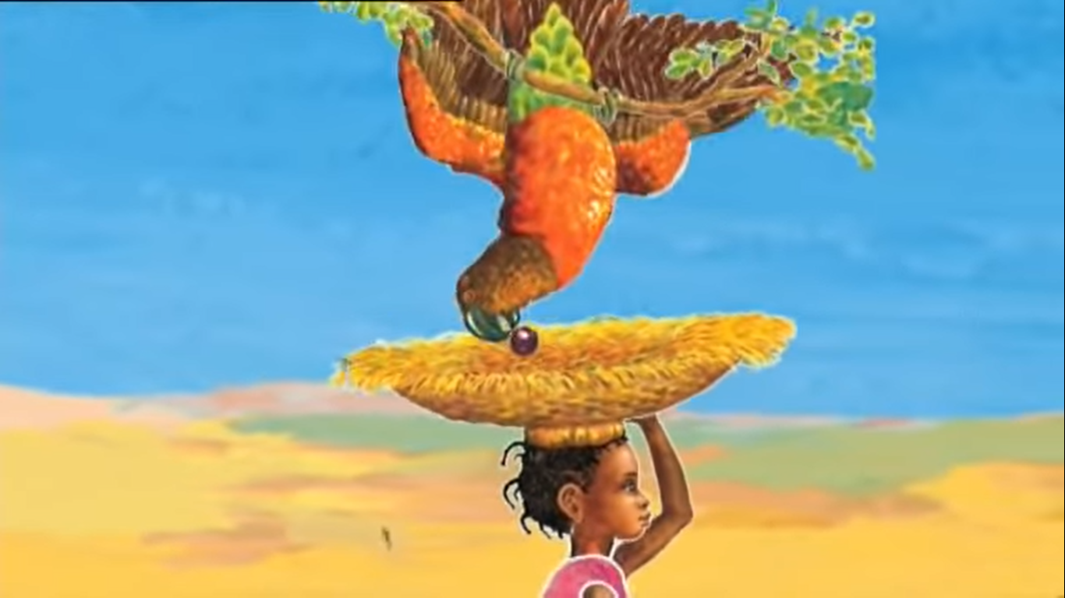
or the tangy, purple passion-fruit?
Feel and taste mashed jelly (for the inside of a passion-fruit)

Slide 12
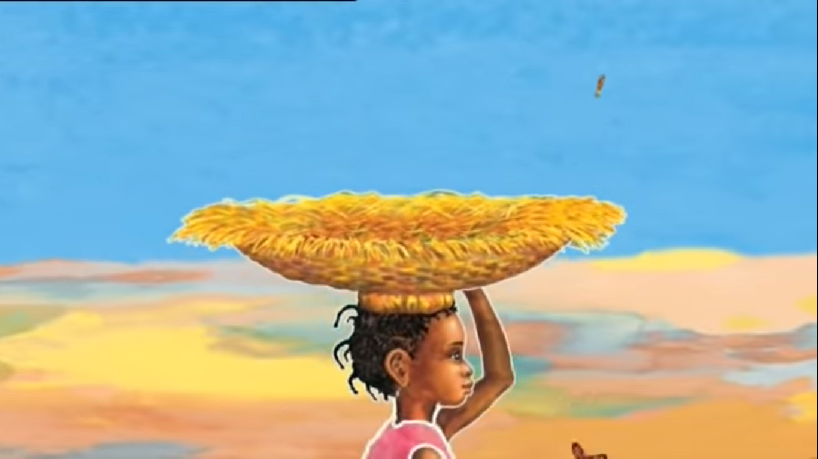
Which fruit will Akeyo like best?

Slide 13
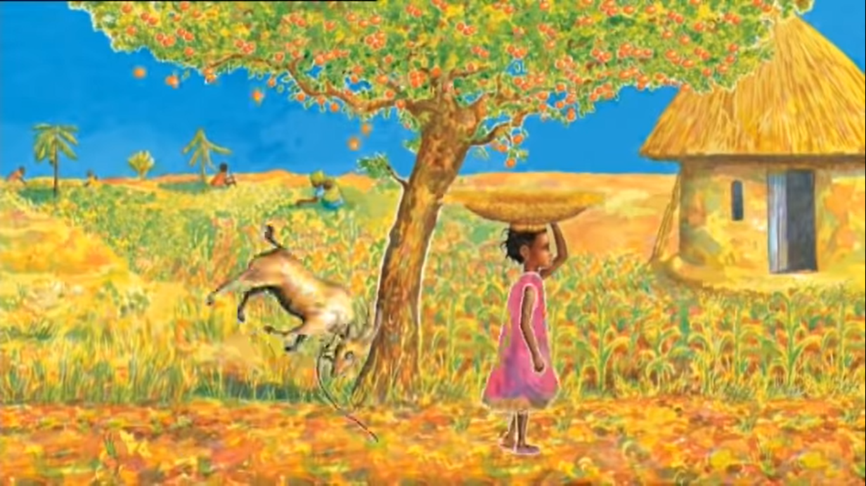

Slide 14
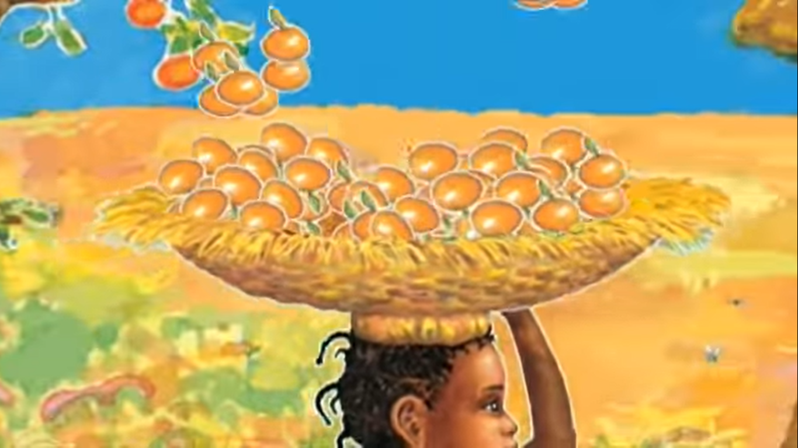
Tip a container of light balls or toys over your child’s head!

Slide 15
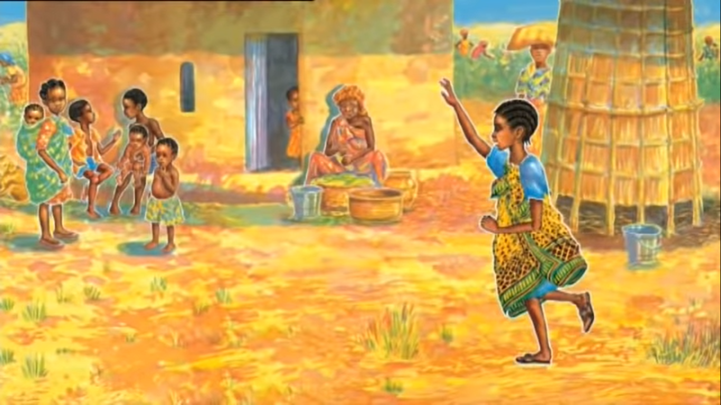
“Hello, Akeyo” said Handa. “I’ve brought you a surprise.”

Slide 16
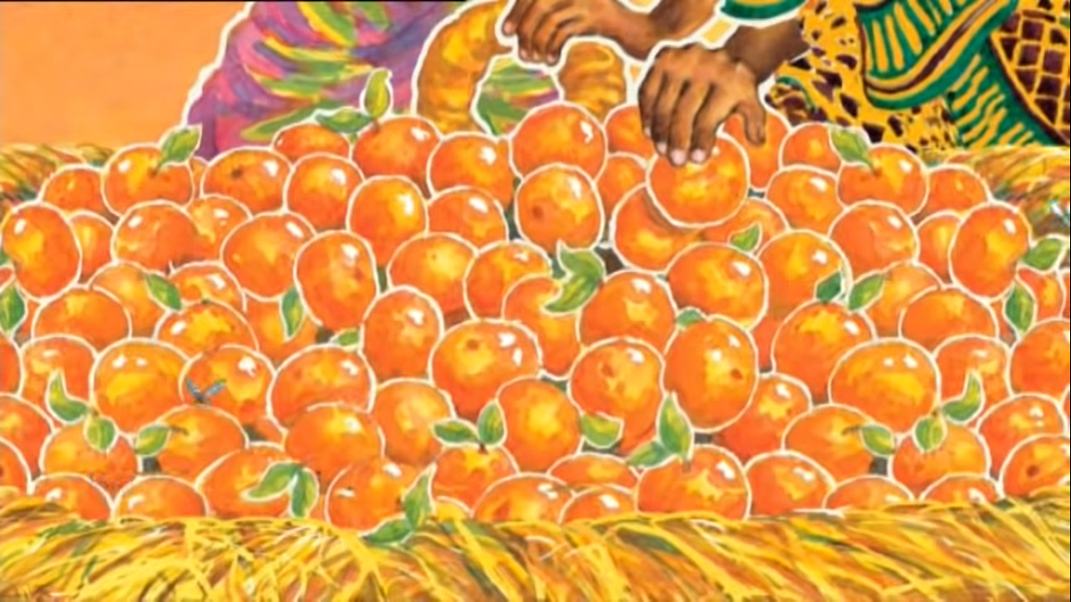
“Tangerines!”, said Akeyo. “My favourite fruit.”

Slide 17
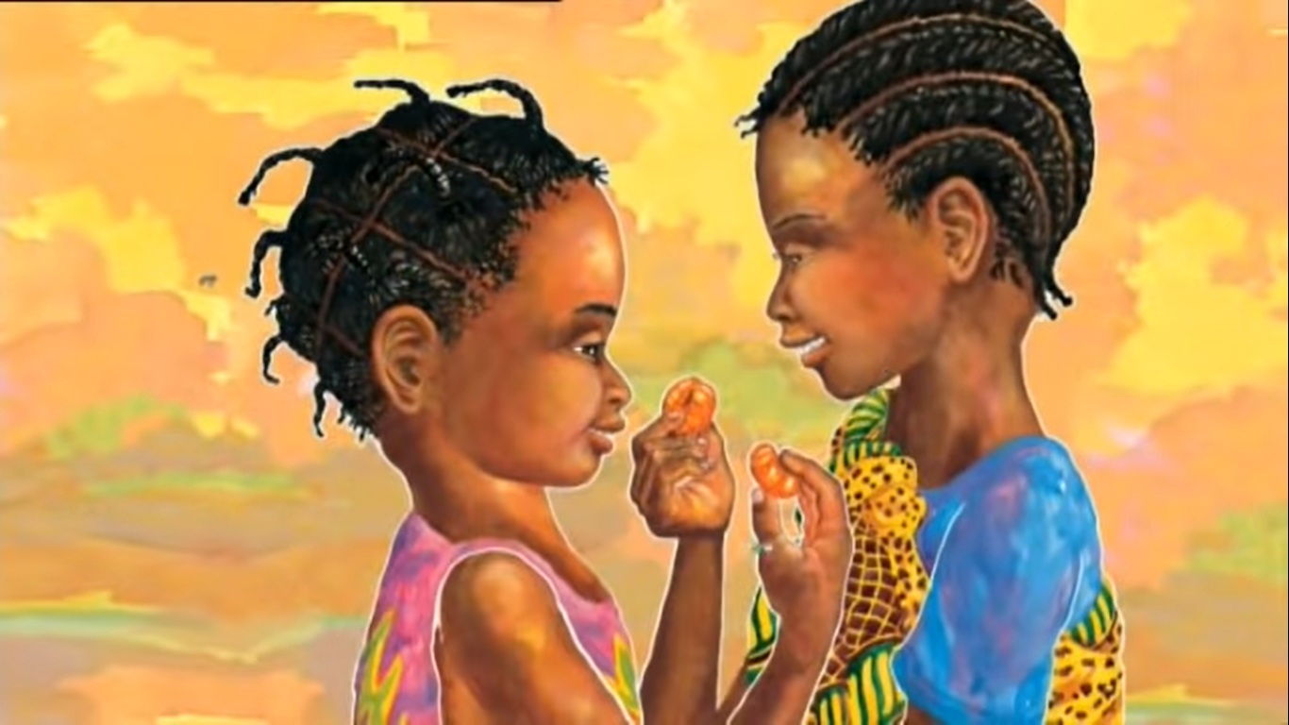
Share a tangerine together.
“TANGERINES?” Said Handa. “That is a surprise!”

