Slide 1
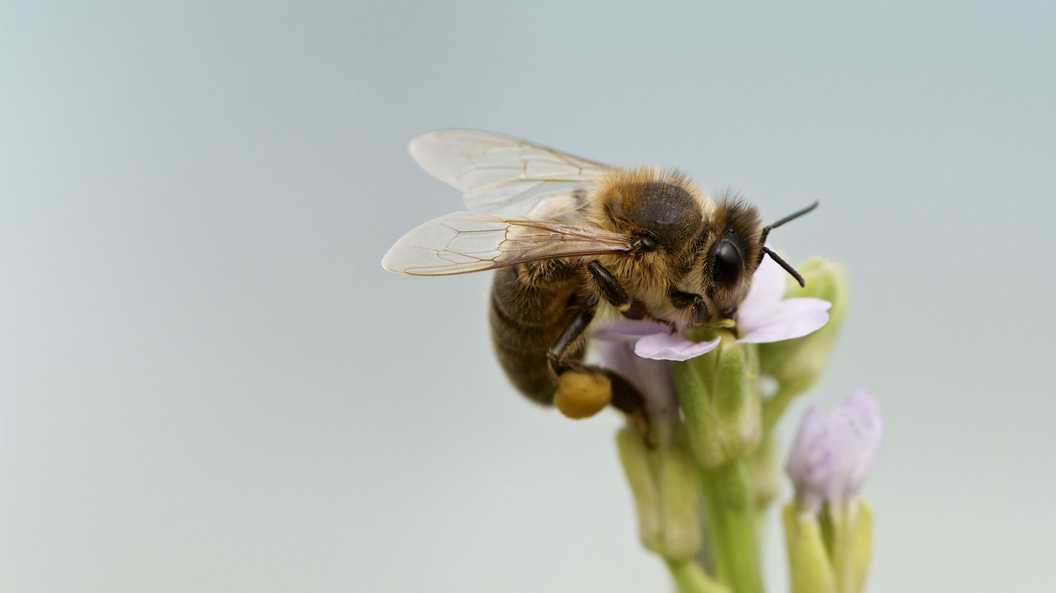
Garden sensory experience
Enjoy your time in the garden

Slide 2
We are going on a sensory hunt. What will we find in our garden.

Slide 3
Shadows: Find the shadows in your garden and walk along the shadow’s edge.

Slide 4
What colourful things can you find in your garden. What colours can you see and how many are there?

Slide 5
Do you have any fruit or vegetables growing in your garden?

Slide 6
What sounds can you hear?
Walk along the different surfaces in your garden. Does the sound change if you jump or stomp on it?
Is the sound loud or quiet ?
Does it make a crunch, squelch, tweet, bark, buzz?

Slide 7
Textures: Can you find smooth, bumpy or slimy things in your garden?

Slide 8
Smells: Do you like the smell of the things in your garden?

Slide 9
Did you like the things you found in your garden?

Slide 10
Garden sensory experience
Hope you enjoyed your sensory garden experience

