Slide 1
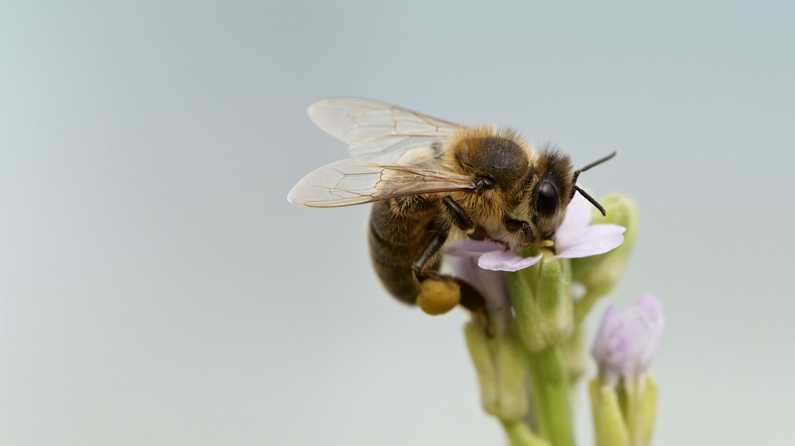
Garden sensory experience
Enjoy your time in the garden

Slide 2
Interoception and Sensory Discrimination
The interoceptive system helps you to detect sensations within your body.
It lets you know when your hungry, unwell, and whether you feel hot or cold. It also informs you about your emotions.
Sensory discrimination allows your body to detect the differences in sensations. For example, when you feel something, your touch senses let you know whether the object is smooth, rough or sticky. By feeling something you can guess what it is, without even looking.

Slide 3
Vision:
Use your eye’s to notice the details in the objects you see. Notice the colour, shape, pattern, and movement of an object.
Your visual senses give you feedback on how safe something is. Would you touch a prickly plant? Is this going to sting.

Slide 4
What colourful things can you find in your garden. Does colour effect your how you feel? For example, do colours make you feel happy or bored?

Slide 5
Smells: Do you like the smell of the things in your garden?
Smells, can generate memories.
The smell of fresh cut grass can remind you of a time of year
The smell of a flower may remind you of a person.
The smell of the tomatoes grown in your garden, can remind you of things you have cooked and then eaten.

Slide 6
Sounds:
Walk along the different surfaces in your garden. Does the sound change if you jump or stomp on it? Does it make a crunch or squelch sound?
Is the sound loud or quiet ?
Can you hear a buzz or tweeting sound
Do you like the sounds in your garden?

Slide 7
Touch:
Your touch senses allows you to detect different textures e.g. soft, hard, bumpy, sharp etc.
The feel of something can be a comfort or cause discomfort. There are different types of touch sensations: light touch, firm touch and vibration.
How would you feel if this feature was stroked up and down your arm. You will probably know how you will feel without even having the experience.

Slide 8
Temperature:
We all like different temperatures. Some like to find a warm sunny spot in the garden. Others, prefer it cool and may sit in the shade.
Temperature is detected by your internal senses (interoceptive senses) and can cause bodily changes.
Notice how your body changes: Do the hairs on your arms stand up, do you shiver, are you sweating or does the temperature help you to relax?
When relaxed, your muscles will feel less tense and heavy. You may focus on the warm sensation and for a moment it may stop you from thinking about other things.

Slide 9
Co-regulation and self regulation:
Regulation is the ability to use your senses and control how you feel. Co-regulation and self regulation is needed for good health and wellbeing. Your interoceptive senses help to detect how you feel. You need to respond to these feeling so that you can feel calm, relaxed and focused.
Think of the things in your garden that make you feel happy. Give yourself the time to experience the things you enjoy.

Slide 10
Garden sensory experience
Hope you enjoyed your sensory garden experience

